Slide 1
Suicide Analysis, Visualizations and Predictive Modelling
Sanat Madkar – B050
Tanay Maheshwari – B053
Mann Merani – B060
Rahil Merchant – B061

Slide 2
Idea
We have seen an alarming rise in suicide rates across the globe over the past few years with suicide rates in 2017 being the highest they’ve been since World War II.
Being the 10th most common cause of death, suicide prevention is a matter of utmost importance.
In order to prevent suicides, there must be a clear understanding of the reasons that could lead an individual to take such drastic steps. For this to be done, previous data can be visualized in order to interpret it in a better manner.
Predictive modelling can go a long way towards trying to get a better picture of the dependency of the number of suicides on various factors. It can be used to predict the number of suicides for any year based on values of correlative attributes.

Slide 3
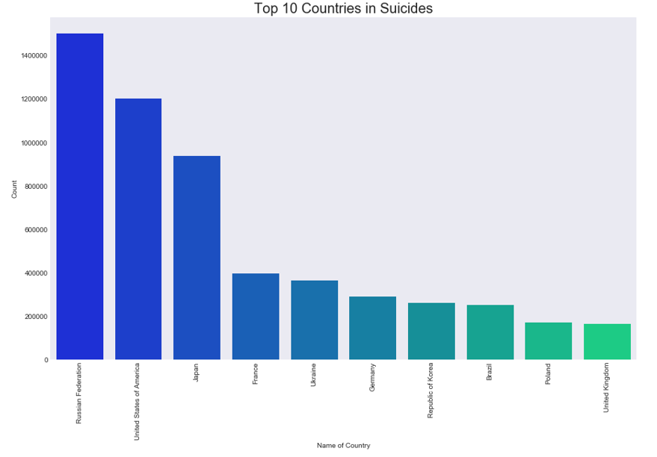
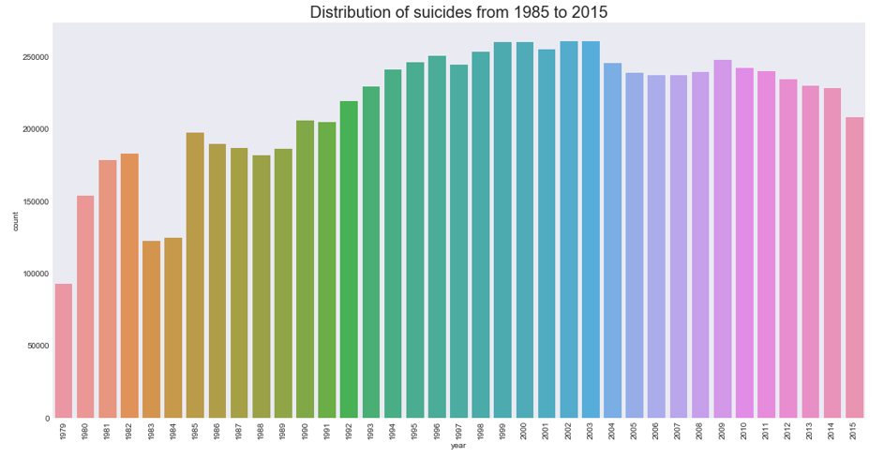
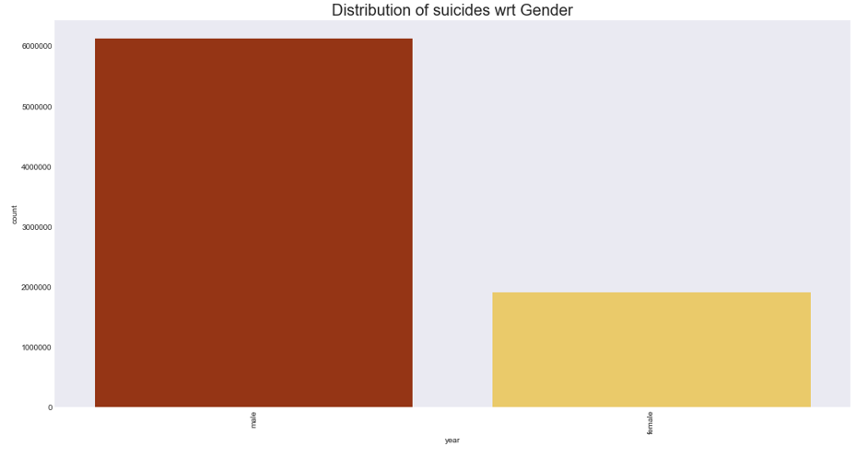
Visualizations

Slide 4
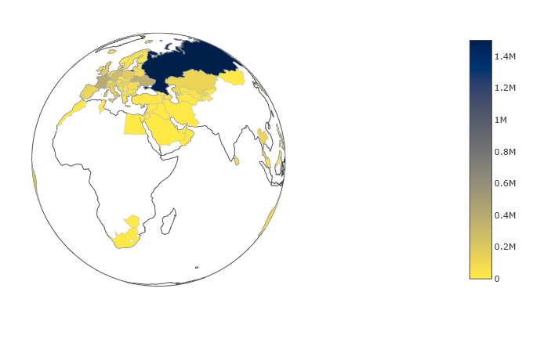
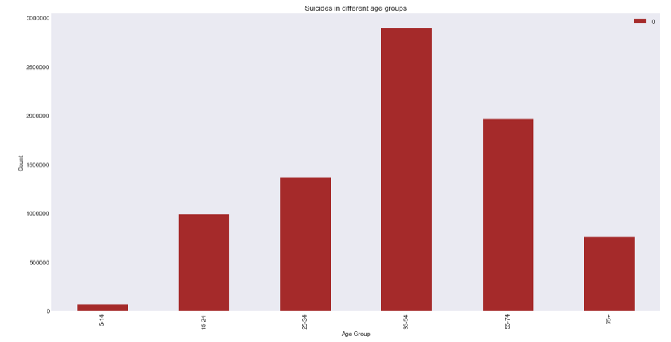
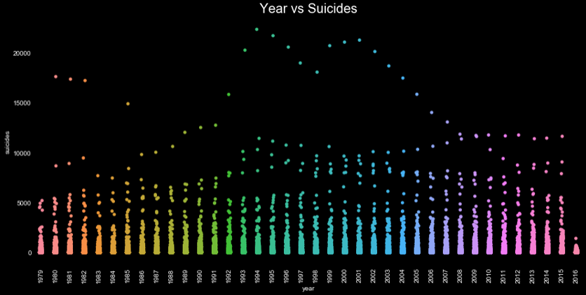

Slide 5
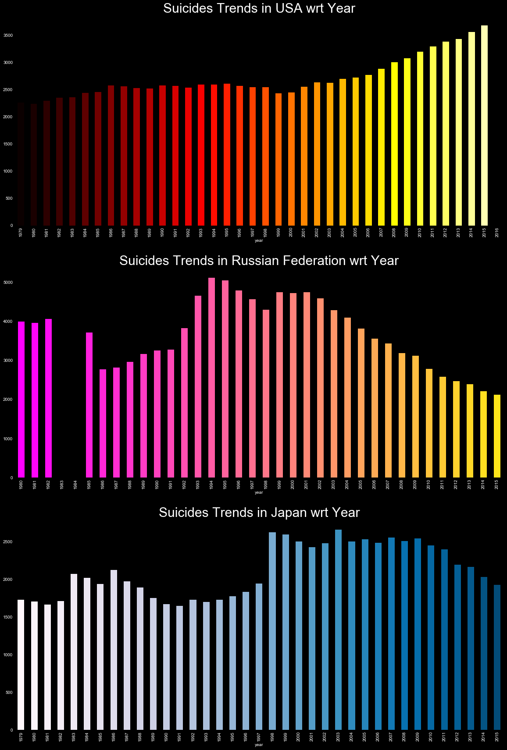
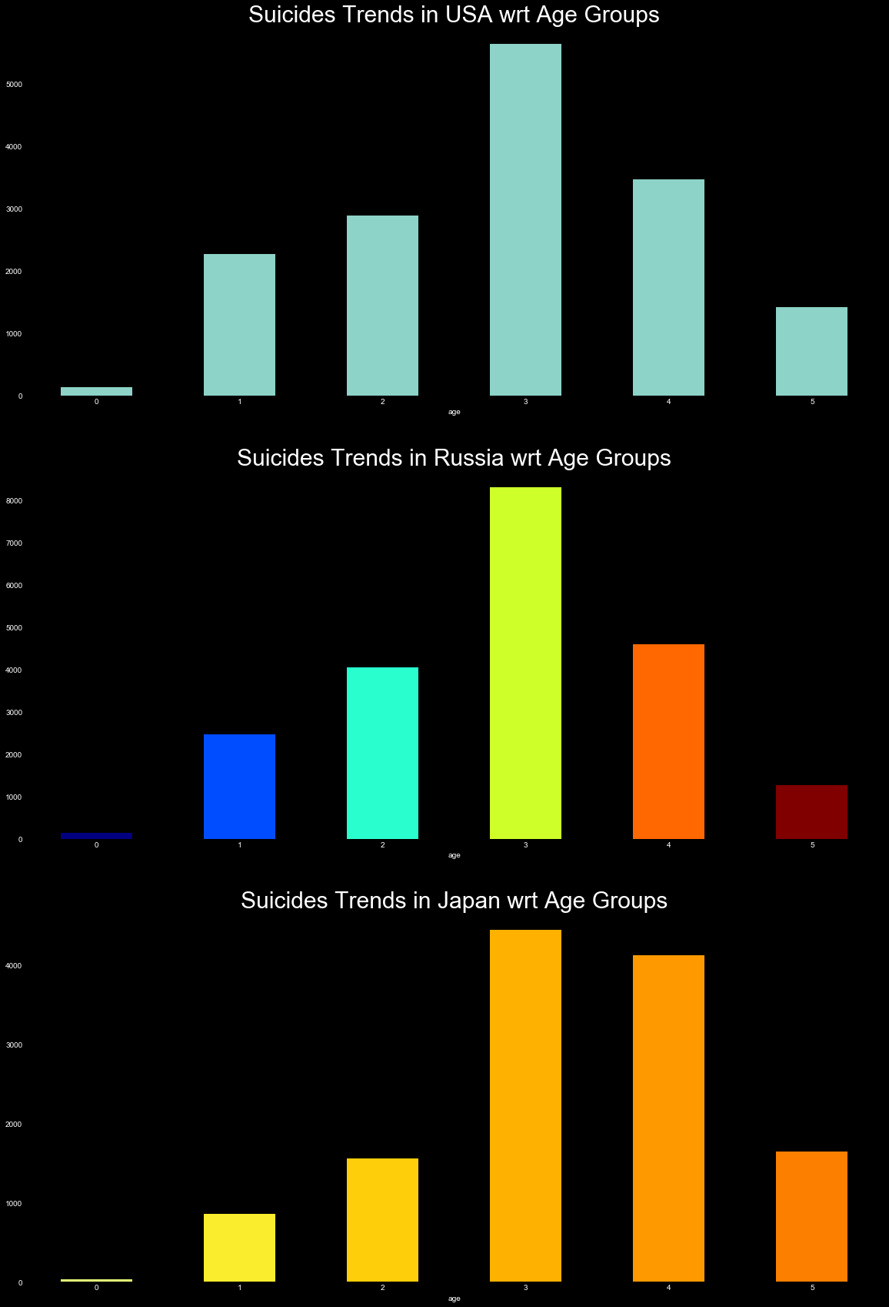

Slide 6
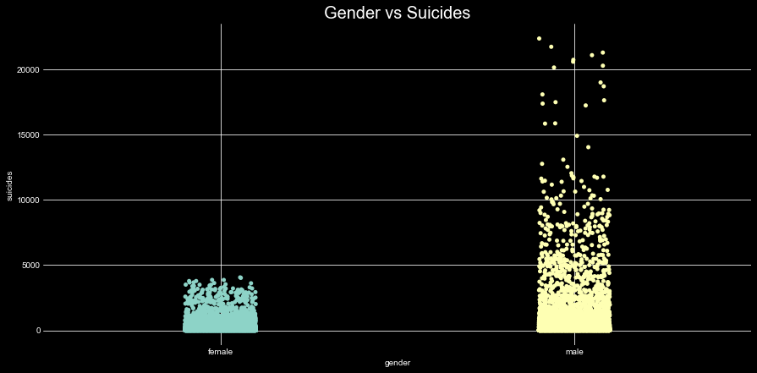
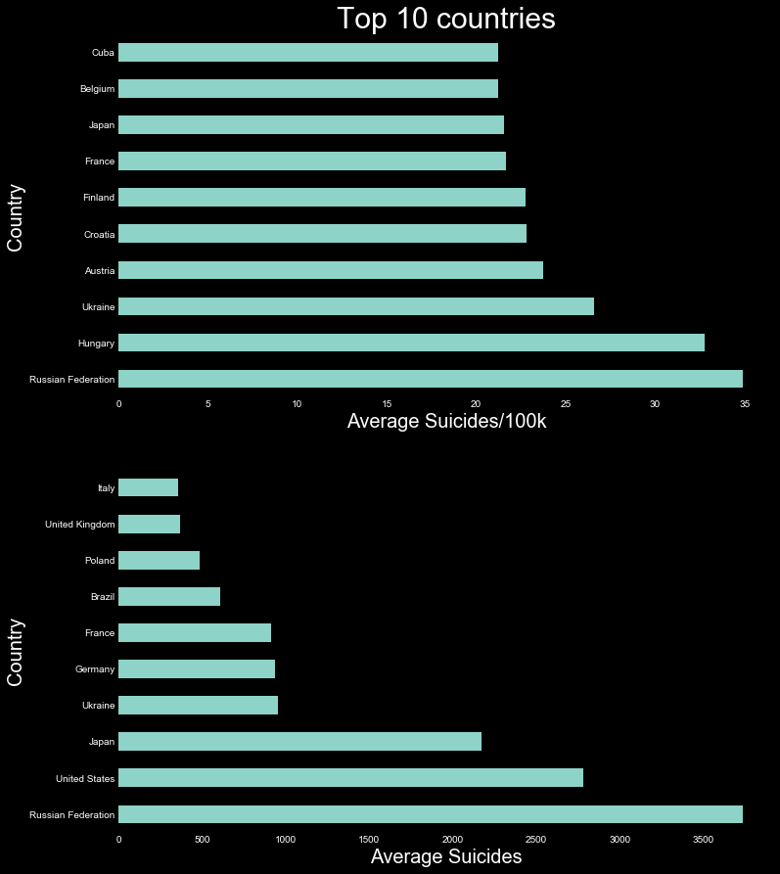
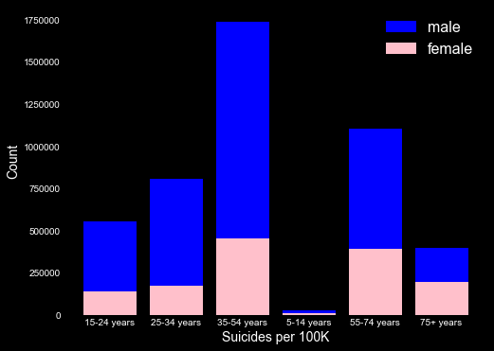

Slide 7
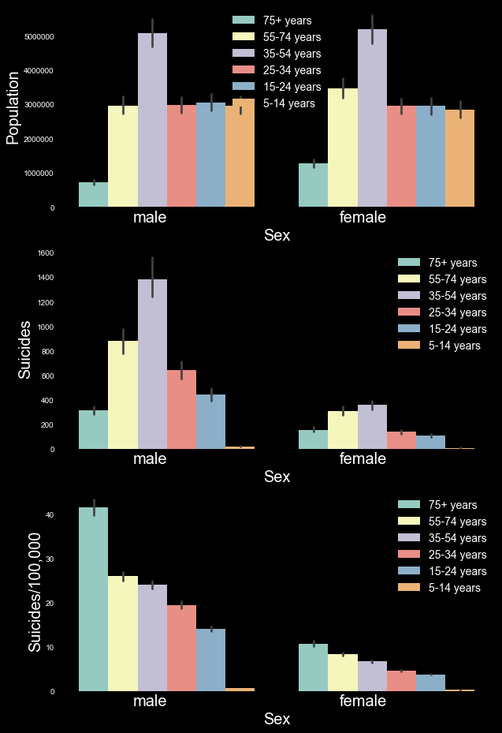
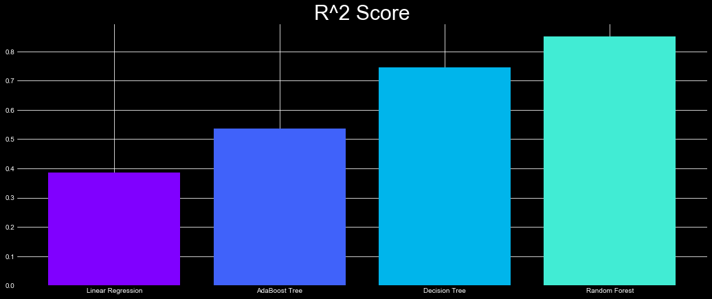
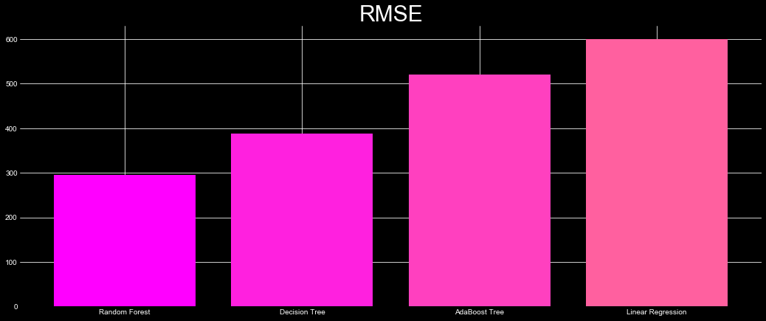

Slide 8
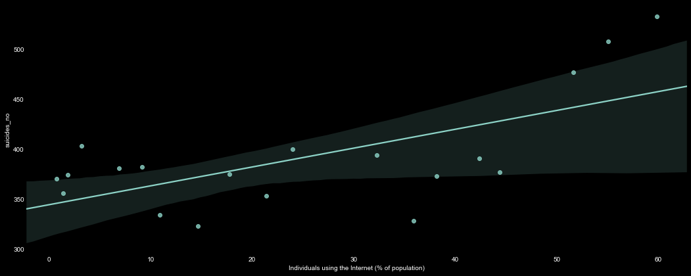
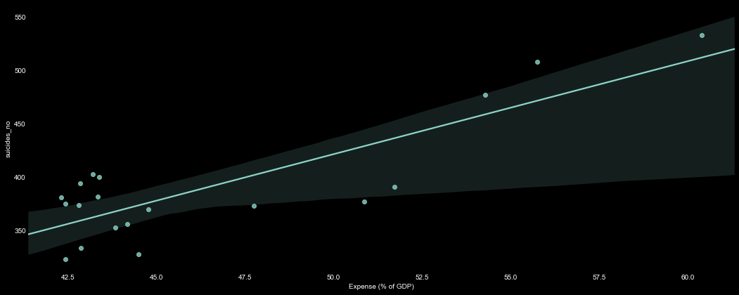

Slide 9
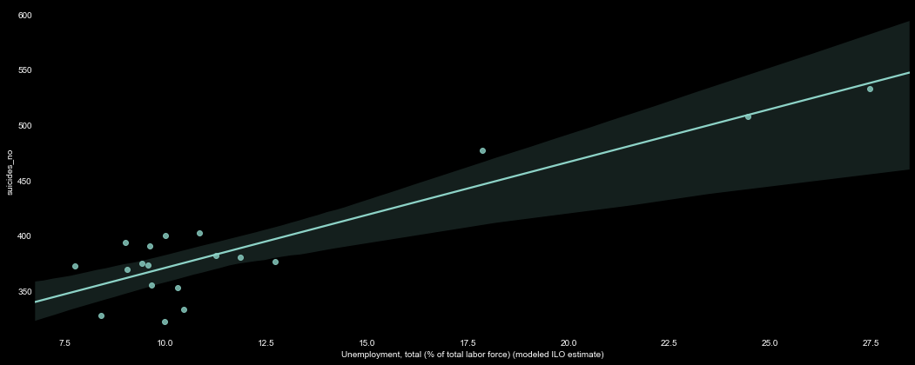
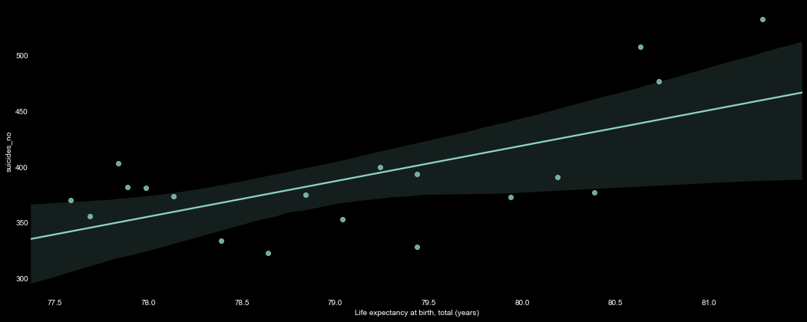

Slide 10
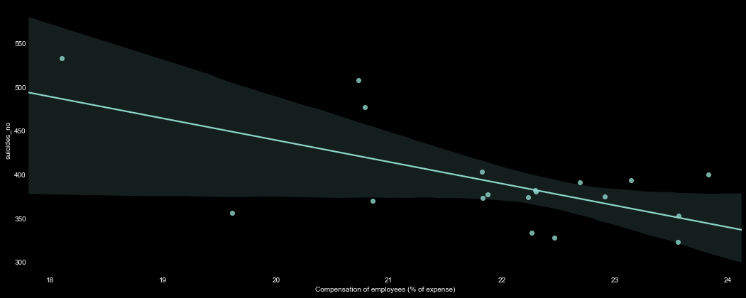

Slide 11
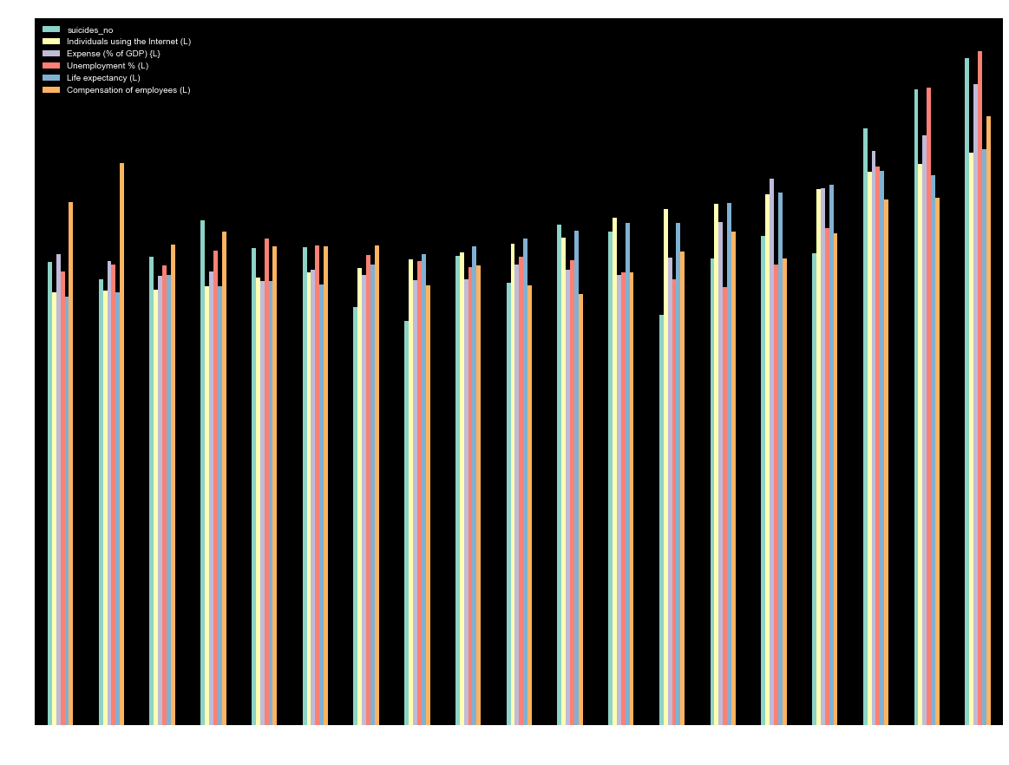

Slide 12
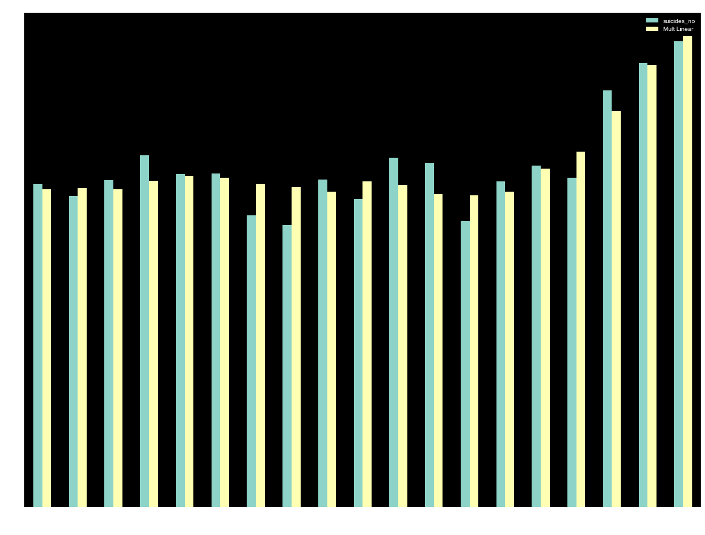

Slide 13
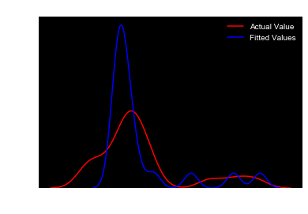
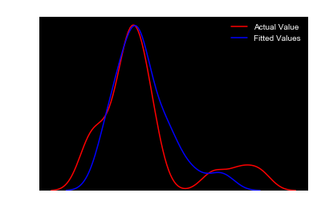
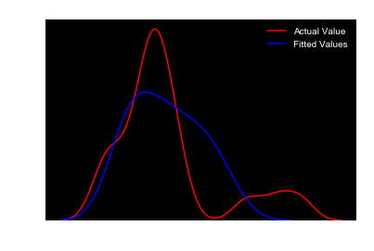
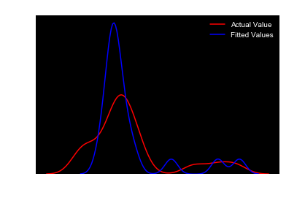
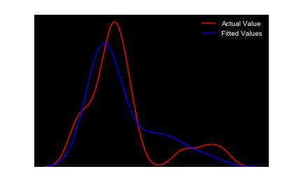
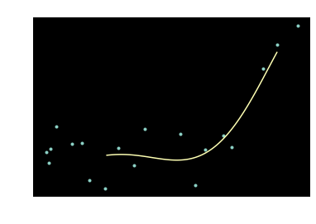

Slide 14
Datasets Used
https://www.kaggle.com/russellyates88/suicide-rates-overview-1985-to-2016
https://www.kaggle.com/dornani/widandsuicide
Above datasets refer to the following datasets:
United Nations Development Program. (2018). Human development index (HDI). Retrieved from http://hdr.undp.org/en/indicators/137506
World Bank. (2018). World development indicators: GDP (current US$) by country:1985 to 2016. Retrieved from http://databank.worldbank.org/data/source/world-development-indicators#
[Szamil]. (2017). Suicide in the Twenty-First Century [dataset]. Retrieved from https://www.kaggle.com/szamil/suicide-in-the-twenty-first-century/notebook
World Health Organization. (2018). Suicide prevention. Retrieved from http://www.who.int/mental_health/suicide-prevention/en/
The World Bank World Development Indicators. Retrieved from https://datacatalog.worldbank.org/dataset/world-development-indicators

Slide 15
Libraries Used
Software Used
Dataframes - Pandas
Visualization - Matplotlib
Visualization - Seaborn
Visualization - Plotly
Mathematical Functions - NumPy
Regression - Scikit-Learn
Python 3.7.3
Anaconda
Jupyter Notebook

Slide 16
Process Followed
Conversion of .csv datasets to Pandas Dataframes
Data Cleaning
Data Wrangling
Exploratory Data Analysis
Data Visualizations
Predictive Modelling
Model Evaluation
Conclusion

Slide 17
Source Code and Dataset files
https://github.com/Rahil-Merchant/Suicide-Analysis-Visualization-and-Modelling

Slide 18
Conclusion
We performed an analysis of existing data on suicides and tried to attain meaningful observations using different visualizations and predictive modelling.
We believe this could be used to pin-point various factors that drive individuals to commit suicide and try and address these issues.
The models developed can be used to predict the effect of different correlative factors with suicide rates.

Slide 19
Thank You!

